Slide 1

STATS 432 Computational Statistics
Tutorial 2 – Permutation Testing (Part II)

Slide 2

Question 1 – Permutation Testing in Two-way ANOVA Context

Slide 3
Question 1:
Question 1
A study is conducted to test whether different dosages of Atorvastatin (10mgs, 20mgs, 30mgs) have any effect on the level of cholesterol within the blood stream of patients. The table below shows the level of cholesterol in patient’s blood streams after taking specified dosages of Atorvastatin each day for a month. This data is also available in the data set entitled ‘Cholesterol.csv’. Since cholesterol levels are likely to be affected by biological sex, the effect of dosage on cholesterol levels must be assessed controlling for sex.
Normal Theory Two-Way ANOVA:
 | Dosage 10mgs | Dosage 20mgs | Dosage 30mgs
Male | 88 | 88 | 71
Male | 75 | 65 | 67
Male | 80 | 81 | 72
Male | 88 | 73 | 80
Male | 83 | 82 | 82
Male | 74 | 85 | 69
Male | 86 | - | 76
Male | 88 | - | 73
Male | 82 | - | 71
Female | 68 | 79 | 66
Female | 78 | 57 | 69
Female | 83 | 74 | 69
Female | 68 | 64 | 53
Female | 74 | 65 | 59
Female | 72 | 72 | 59
Female | 62 | 68 | 76
Female | - | 72 | 74
Female | - | 75 | -
Specify the response variable, factors and factor levels present in this study.
Write down the two-way ANOVA model as it applies in this instance.
Construct a marginal means plot. What does this suggest with regards to the presence on an interaction term between dosage and sex?
Conduct normal theory two-way ANOVA, to test for the effects of sex, dosage controlling for sex and the presence of any interaction between dosage and sex? Will it matter in which order the factors are entered into the model in this instance?
Permutation Testing:
Due to the small sample size in some cells, there is concern that the conditions of normal theory two-way ANOVA (i.e. independence, normality and homogeneity of variance) may not be satisfied. Conduct permutation tests to:
Test for interaction effects using Ter Braak’s method.
Test for the effect of sex on cholesterol alone.
Test for the effect of dosage controlling for sex.
3
Associated code = Tutorial 2

Slide 4

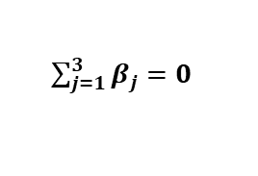
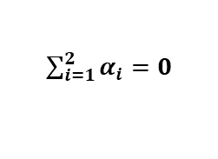
Question 1:
Question 1
Specify the response variable, factors and factor levels present in this study.
Write down the two-way ANOVA model as it applies in this instance.
Response Variable: Cholesterol level of patients (in mgs)
Factor A: Sex
Factor A Levels: Male, Female (a=2)
Factor B: Dosage of Atorvastatin
Factor B Levels: 10mgs, 20mgs, 30mgs (b=3)
$$Y_{ijk} = μ + α_{i} + β_{j} + {\left(αβ\right)}_{ij} + ε_{ijk}$$
$$∀ i=1, 2 j=1,2,3 k=k\left(ij\right) \\ ε_{ijk} \sim N(0, σ^{2})$$
$\sum_{i=1}^{2}{α_{i}=0}$
$\sum_{j=1}^{3}{β_{j}=0}$
Construct a marginal means plot. What does this suggest with regards to the presence on an interaction term between dosage and sex?
See Section 1.1a1 of the code
 | 10mgs | 20mgs | 30mgs
Male | 82.67 | 79.00 | 73.44
Female | 72.14 | 69.56 | 65.63
Marginal means plot suggests no evidence of interaction between dosage and sex.
4
Associated code = Tutorial 2

Slide 5
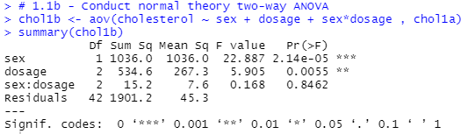
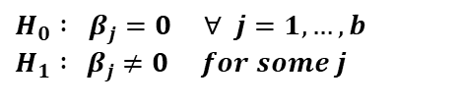
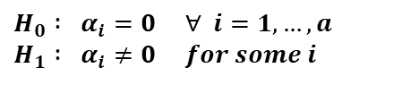

Question 1:
Question 1
Conduct normal theory two-way ANOVA to test for the effects of sex, dosage controlling for sex and the presence of any interaction between dosage and sex? Will it matter in which order the factors are entered into the model in this instance?
Since cholesterol levels are likely to be affected by biological sex, the effect of dosage on cholesterol levels must be assessed controlling for sex. As such, sex should be entered into the model first.
See Section 1.1b of the code
No evidence for an interaction between sex and dosage F = 0.168, df = (2,42), p-value = 0.8462
Very strong evidence for an effect of sex on cholesterol level F = 22.887, df = (1,42), p-value = 2.14e-05
Very strong evidence for an effect of dosage on cholesterol levels after controlling for sex F = 5.905, df = (2,42), p-value = 0.0055
Is there any interaction between factors?
$$H_{0} : {(αβ)}_{ij} =0 ∀ i,j \\ H_{1} :{ (αβ)}_{ij} ≠0 for some i,j$$
Does factor A have any effect on Y?
Does factor B have any effect on Y conditional on A?
$$H_{0} : α_{i}=0 ∀ i=1, …, a \\ H_{1} : α_{i}≠0 for some i$$
$$H_{0} : β_{j}=0 ∀ j=1, …, b \\ H_{1} :{ β}_{j} ≠0 for some j$$
5
Associated code = Tutorial 2

Slide 6
Question 1:
Question 1
Due to the small sample size in some cells, there is concern that the conditions of normal theory two-way ANOVA (i.e. independence, normality and homogeneity of variance) may not be satisfied. If so, the results of normal theory two-way ANOVA will be meaningless.
 | Dosage 10mgs | Dosage 20mgs | Dosage 30mgs
Male | 88 | 88 | 71
Male | 75 | 65 | 67
Male | 80 | 81 | 72
Male | 88 | 73 | 80
Male | 83 | 82 | 82
Male | 74 | 85 | 69
Male | 86 | - | 76
Male | 88 | - | 73
Male | 82 | - | 71
Female | 68 | 79 | 66
Female | 78 | 57 | 69
Female | 83 | 74 | 69
Female | 68 | 64 | 53
Female | 74 | 65 | 59
Female | 72 | 72 | 59
Female | 62 | 68 | 76
Female | - | 72 | 74
Female | - | 75 | -
We will have to test for…
Interaction between sex and dosage
The effect of sex on cholesterol levels
The effect of dosage on cholesterol levels controlling for sex
… by conducting permutation tests.
6
Associated code = Tutorial 2

Slide 7
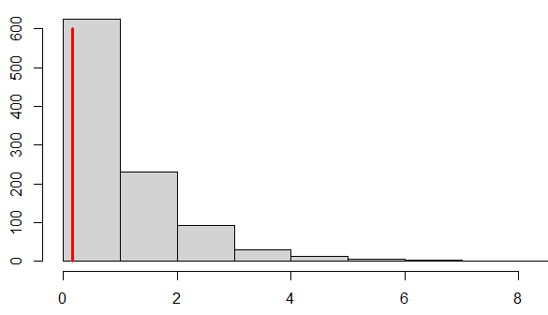
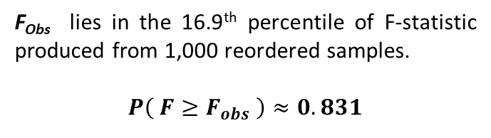
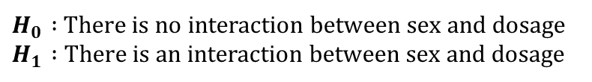
Question 1:
Question 1
Conduct a permutation test to test for interaction effects using Ter Braak’s method.
See Section 2 of the code
Histogram of F-Statistics Produced from 1,000 Reordered Samples
F_{obs} = 0.1678
$H_{0} :$ There is no interaction between sex and dosage $H_{1} :$ There is an interaction between sex and dosage
F_{Obs} lies in the 16.9th percentile of F-statistic produced from 1,000 reordered samples.
$$P\left( F≥F_{obs} \right)≈0.831$$
Permutation test yields no evidence against H₀. Conclude that there is no interaction between sex and dosage
7
Associated code = Tutorial 2

Slide 8
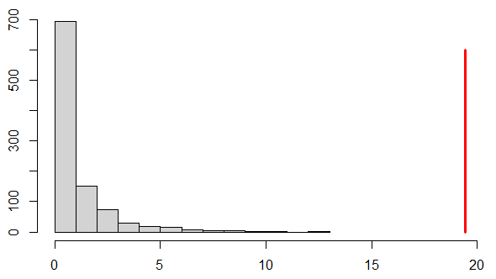
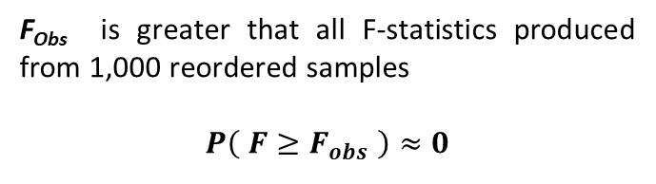
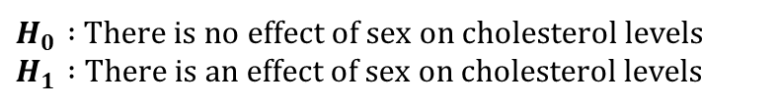
Question 1:
Question 1
Conduct a permutation test to test for the effect of sex on cholesterol alone.
See Section 3 of the code
Histogram of F-Statistics Produced from 1,000 Reordered Samples
$H_{0} :$ There is no effect of sex on cholesterol levels $H_{1} :$ There is an effect of sex on cholesterol levels
F_{obs} = 19.44
F_{Obs} is greater that all F-statistics produced from 1,000 reordered samples
$$P\left( F≥F_{obs} \right)≈0$$
Permutation test yields very strong evidence against H₀. Conclude that there is an effect of sex on cholesterol levels.
8
Associated code = Tutorial 2

Slide 9
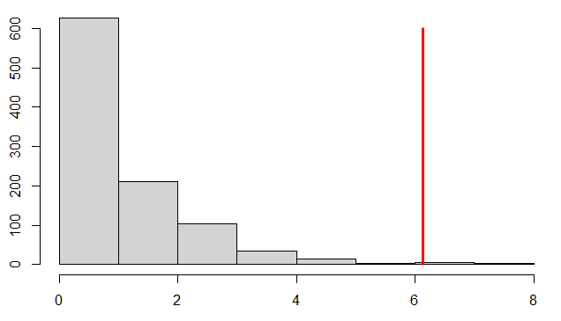
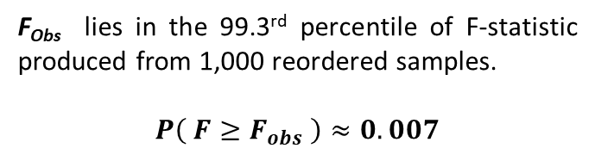
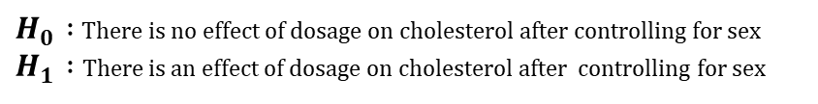
Question 1:
Question 1
Test for the effect of dosage controlling for sex.
See Section 4 of the code
Histogram of F-Statistics Produced from 1,000 Reordered Samples
F_{obs} = 6.137
$H_{0} :$ There is no effect of dosage on cholesterol after controlling for sex $H_{1} :$ There is an effect of dosage on cholesterol after controlling for sex
F_{Obs} lies in the 99.3rd percentile of F-statistic produced from 1,000 reordered samples.
$$P\left( F≥F_{obs} \right)≈0.007$$
Permutation test yields very strong evidence against H₀. Conclude that there is an effect of dosage on cholesterol after controlling for sex.
9
Associated code = Tutorial 2

Slide 10
Question 2 – Permutation Testing in a GLM Context

Slide 11
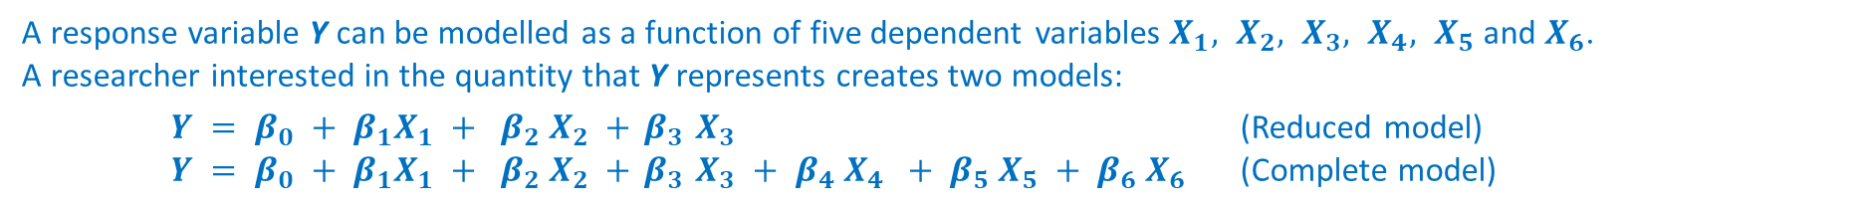
Question 2:
Question 2
A response variable Y can be modelled as a function of five dependent variables $X_{1}, X_{2}, X_{3}, X_{4}, X_{5}$ and $X_{6}$.
A researcher interested in the quantity that Y represents creates two models:
$Y = β_{0} + β_{1}X_{1} + β_{2} X_{2} +{ β}_{3} X_{3}$ (Reduced model)
$Y = β_{0} + β_{1}X_{1} + β_{2} X_{2} +{ β}_{3} X_{3} + β_{4} X_{4} + β_{5} X_{5} + β_{6} X_{6}$ (Complete model)
Y | X1 | X2 | X3 | X4 | X5 | X6
-9.3 | 6 | 90 | 51 | 62 | 72 | 94
55.3 | 34 | 67 | 70 | 86 | 84 | 99
26.1 | 71 | 86 | 28 | 96 | 94 | 53
105.3 | 49 | 49 | 65 | 51 | 41 | 89
46.3 | 30 | 4 | 27 | 97 | 92 | 36
252.6 | 94 | 29 | 87 | 18 | 18 | 44
264.4 | 49 | 2 | 87 | 39 | 37 | 45
144.4 | 41 | 33 | 78 | 97 | 92 | 62
208.7 | 85 | 28 | 74 | 86 | 92 | 73
148.8 | 1 | 8 | 87 | 22 | 22 | 41
67.3 | 88 | 33 | 8 | 55 | 60 | 47
68.1 | 81 | 70 | 14 | 44 | 44 | 19
111.4 | 32 | 33 | 61 | 61 | 52 | 85
226.6 | 63 | 31 | 82 | 43 | 52 | 5
240.8 | 73 | 9 | 66 | 39 | 36 | 32
120.7 | 87 | 33 | 13 | 63 | 55 | 69
The data pertaining to this experiment can be found in the data set entitled ‘Reg Coeff.csv’. A snapshot is shown adjacent.
Read the data set into R and construct a correlation plot of all variables. Comment on the graphs produced.
Conduct a normal theory likelihood ratio test. State the hypothesis being tested, the F-statistic, degrees of freedom, p-value and conclusion of the test.
Construct a QQ-plot of the residuals of the reduced model. Are the residuals normally distributed? Is your analysis from part b) valid?
Conduct a permutation based likelihood ratio test to test between the reduced and complete model.
11
Associated code = Tutorial 2 – Bonus Question

Slide 12
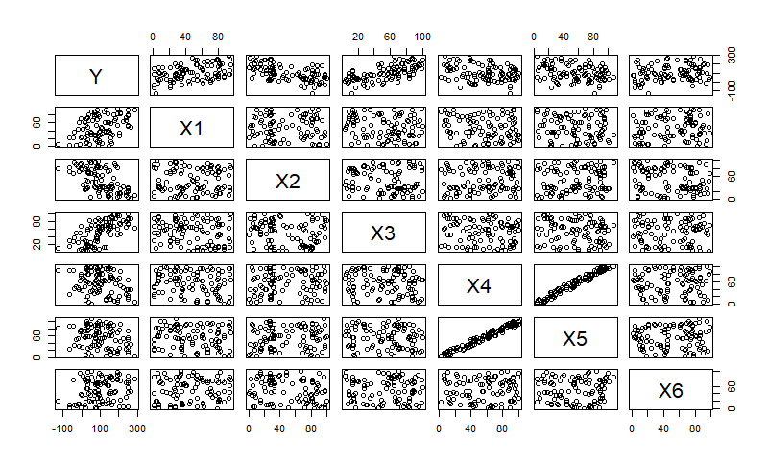
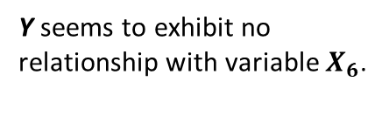
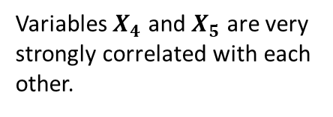
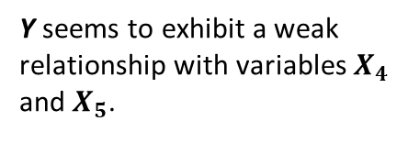
Question 2:
Question 2
Read the data set into R and construct a correlation plot of all variables. Comment on the graphs produced?
See Section 1.1a of the code
Y seems to exhibit a weak relationship with variables $X_{4}$ and $X_{5}$.
Variables $X_{4}$ and $X_{5}$ are very strongly correlated with each other.
Y seems to exhibit no relationship with variable $X_{6}$.
12
Associated code = Tutorial 2 – Bonus Question

Slide 13
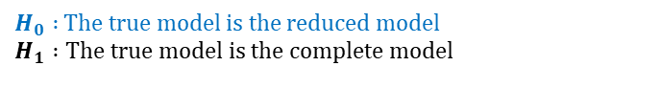
Question 2:
Question 2
Conduct a normal theory likelihood ratio test. State the hypothesis being tested, the F-statistic, degrees of freedom, p-value and conclusion of the test.
See Section 1.1 of the code
# 1.1b - Obtain SSE for complete model
> Reg1b <- lm(Y ~ X1 + X2 + X3 + X4 + X5 + X6, data = Reg1a)
> Reg1b1 <- sum( resid(Reg1b)^2 )
# 1.1c - Obtain SSE for reduced model
> Reg1c <- lm(Y ~ X1 + X2 + X3, data = Reg1a)
> Reg1c1 <- sum( resid(Reg1c)^2 )
# 1.1d - Obtain F-statistic for initial sample
> Reg1d <- ( (Reg1c1 - Reg1b1) / 3 ) / (Reg1b1 / (n - p) )
# 1.1e - Obtain p-value for the test
> 1 - pf(Reg1d, 3, n-p )
$H_{0} :$ The true model is the reduced model $$H_{1} :\text{The} \text{true} \text{model} \text{is} \text{the} \text{complete} \text{model}$$
$H_{0} :$ The extra predictors in the complete model have no relationship with Y when the variables in the reduced model are accounted for.
$H_{1} :$ The extra predictors in the complete model have some relationship with Y even when the variables in the reduced model are accounted for.
F-Statistic = 5.089205 on df=(3, 96)
-> p-value = 0.00262
Strong evidence against H₀
Conclude that the extra predictors in the complete model have some relationship with Y even when the variables in the reduced model are accounted for.
13
Associated code = Tutorial 2 – Bonus Question

Slide 14
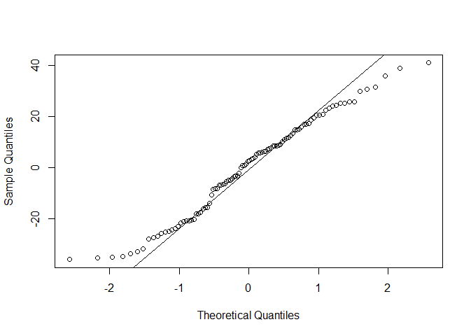
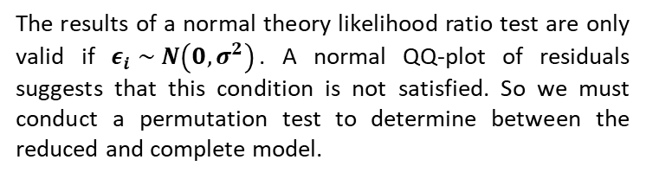
Question 2:
Question 2
Construct a QQ-plot of the residuals of the reduced model. Are the residuals normally distributed? Is your analysis from part b) valid?
See Section 1.1f of the code
# 1.1f - Construct a QQ-Plot of residuals from the reduced model > qqnorm(Reg1c$res, main="")
> qqline(Reg1c$res)
The results of a normal theory likelihood ratio test are only valid if $ε_{i} \sim N\left(0, σ^{2}\right)$. A normal QQ-plot of residuals suggests that this condition is not satisfied. So we must conduct a permutation test to determine between the reduced and complete model.
14
Associated code = Tutorial 2 – Bonus Question

Slide 15
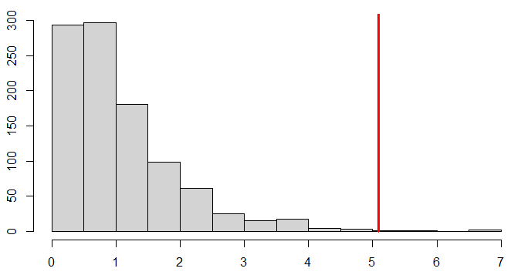

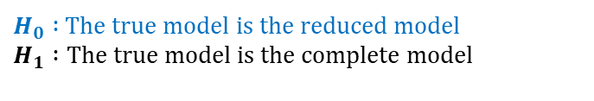
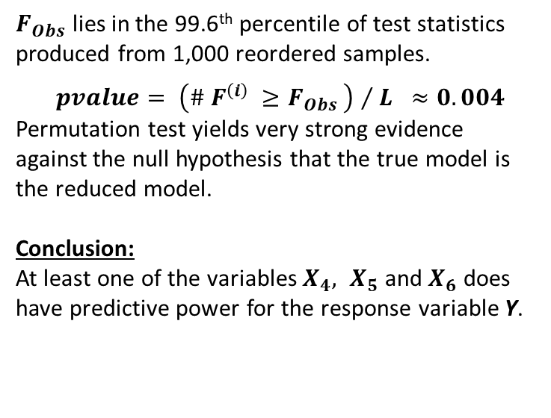
Question 2:
Question 2
Conduct a permutation based likelihood ratio test to test between the reduced and complete model.
See Section 2 of the code
$H_{0} :$ The true model is the reduced model $$H_{1} :\text{The} \text{true} \text{model} \text{is} \text{the} \text{complete} \text{model}$$
Histogram of F-Statistics Produced from 1,000 Reordered Samples
$F_{Obs}$ lies in the 99.6th percentile of test statistics produced from 1,000 reordered samples.
$pvalue= {\left(\# F^{\left(i\right)} ≥F_{Obs} \right) }/{ L} ≈0.004$
Permutation test yields very strong evidence against the null hypothesis that the true model is the reduced model.
Conclusion: At least one of the variables $X_{4}, X_{5}$ and $X_{6}$ does have predictive power for the response variable Y.
$$F_{Obs}=5.089$$
15
Associated code = Tutorial 2 – Bonus Question

